Slide 1

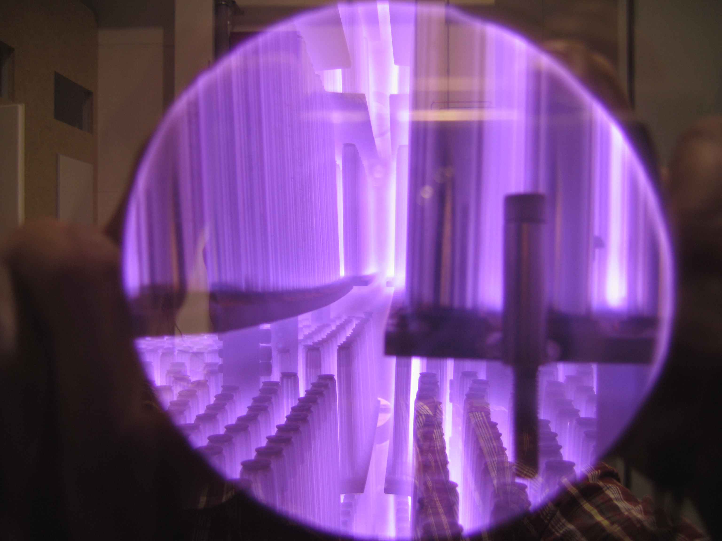
Pulsed Power Supplies
MAGPULS GmbH
For Plasma Nitriding Process

Slide 2
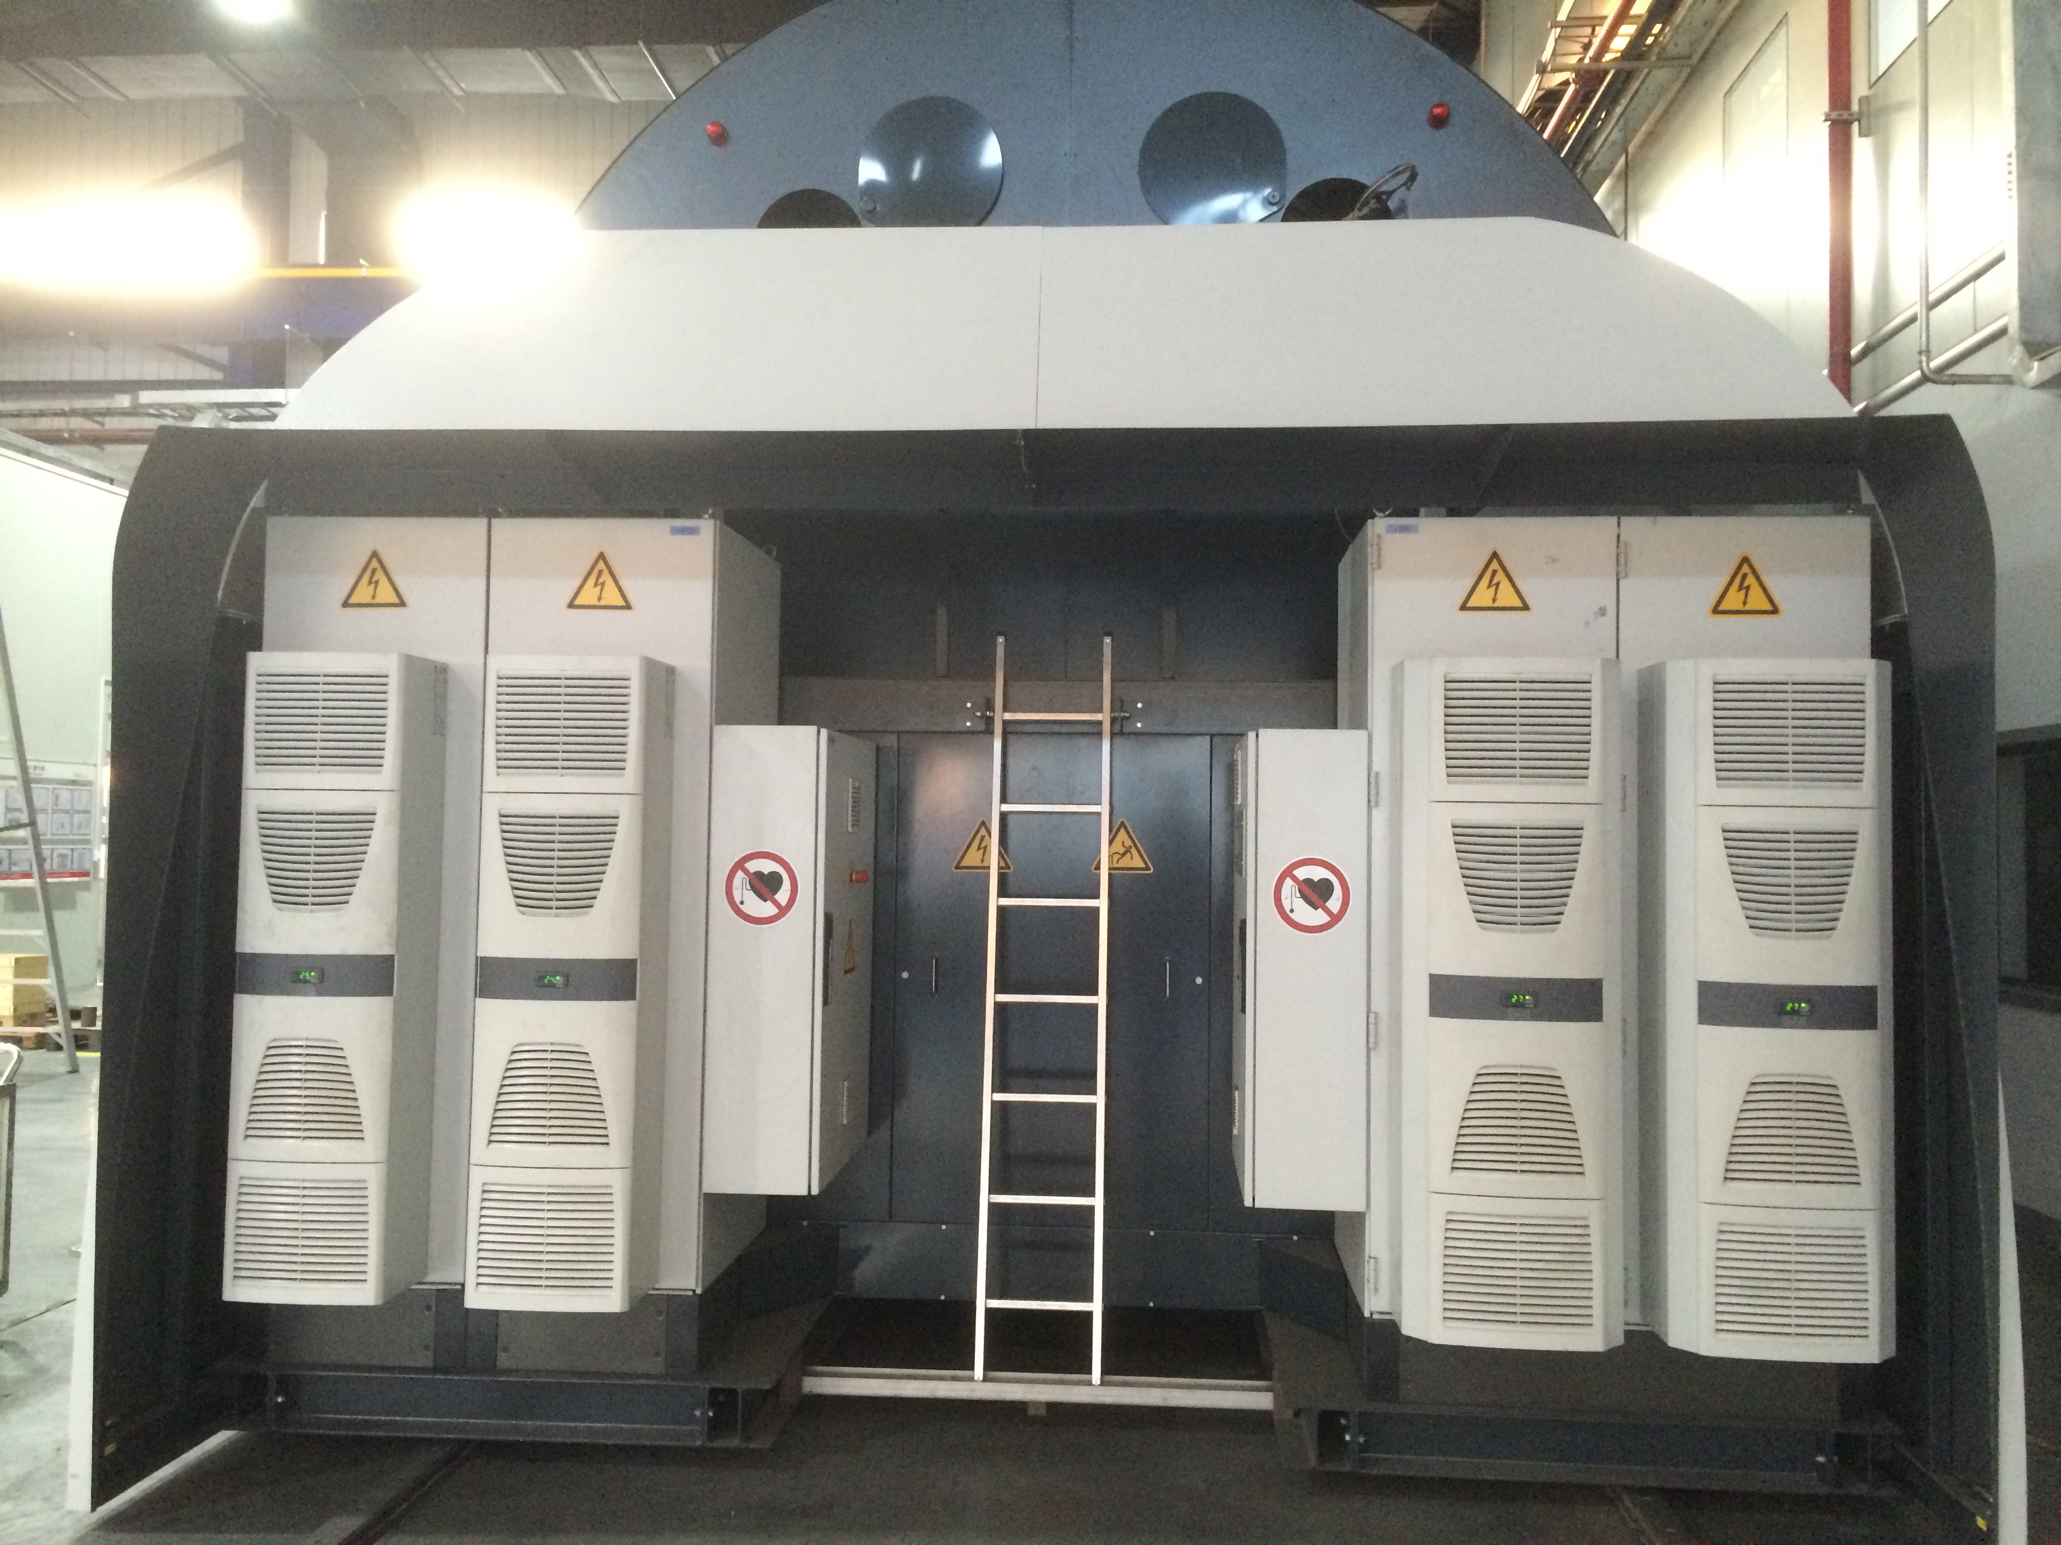
MAGPULS QT-1000/600/1500 bp QuickSwap
MAGPULS GmbH
Pulsed power supply for Plasma Nitriding with vacuum chamber size of:
L x D = 15 m x 5 m
Technical data:
DC Power : 0 – 600kW DC
Pulse current: up to 1500A peak
DC current: 0 – 600A DC
Pulse Voltage: 50 -1000V
Puse On time: 5µs – 1000 µs
Pulse Pause time: 5µs - 1000 µs
Pulse frequency: DC/ 500 Hz – 16 kHz
Duty Cycle: 0,1 % up to 99,5 %
Cooling: Water cooling and air condition
Ambient Temp.: 10°C up to 45° C
Mechanical data:
Pulse unit: Cabinet HxBxT = 2200x1200x800mm
DC power sypply: Cabinet HxBxT = 2200x1200x800mm
Construction:
Pulse unit is built up in 19“ rack mount units mounted in a cabinet with copper rail systems at the rear side for easy service and inspection.
DC power supply in thyristor controlled technology

Slide 3
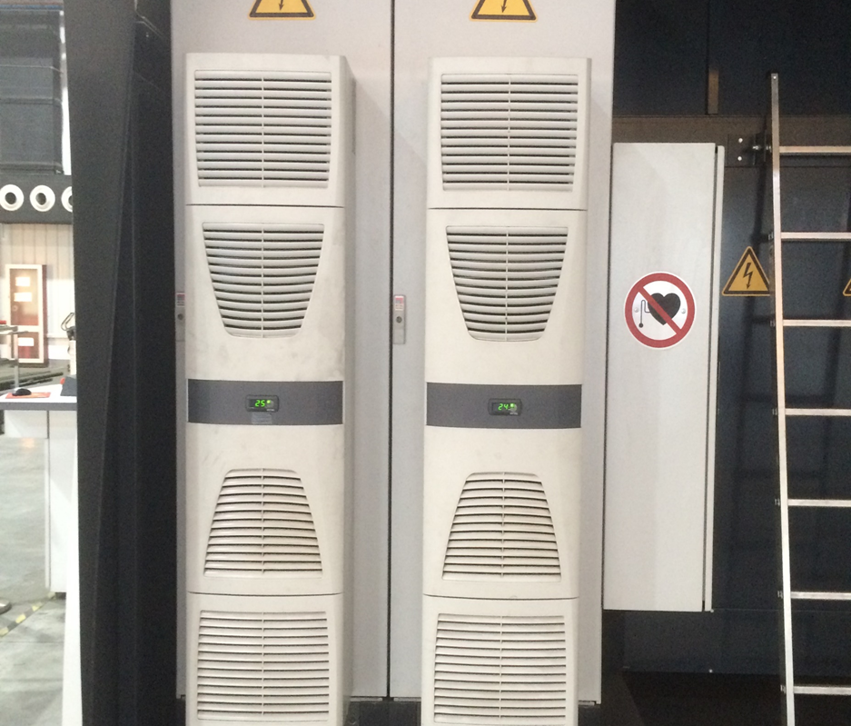
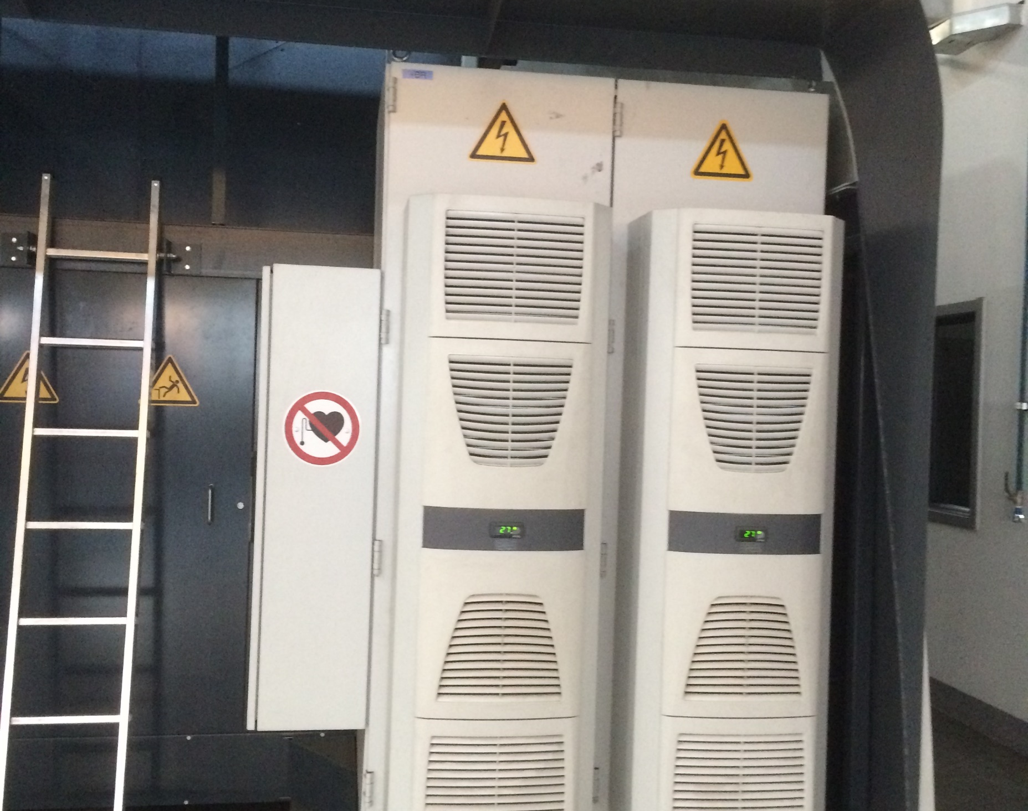
MAGPULS QT-1000/600/1500 up QuickSwap
MAGPULS GmbH
Pulse power cbinet
DC power cbinet

Slide 4
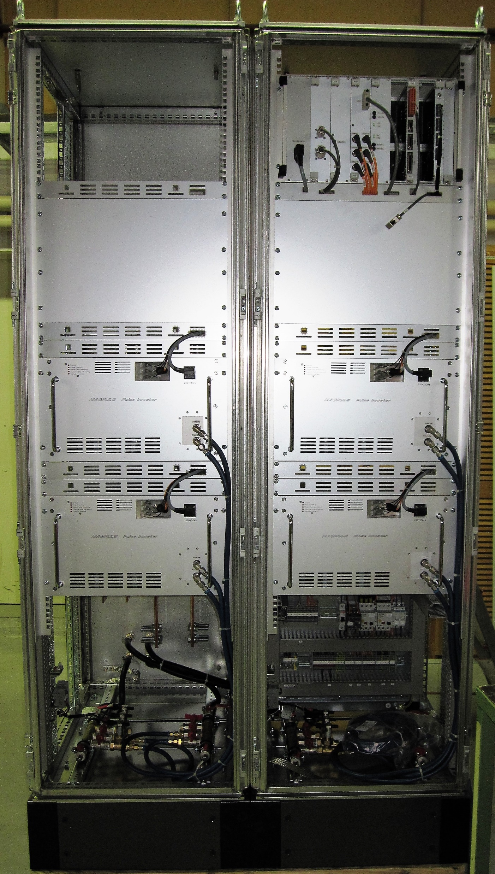
Internal construction of the MAGPULS QT 1000/600/1500 bp
MAGPULS GmbH
Control unit
Place for upgrade of higher pulse power
Pulse booster
300A DC / 750A peak current

Slide 5
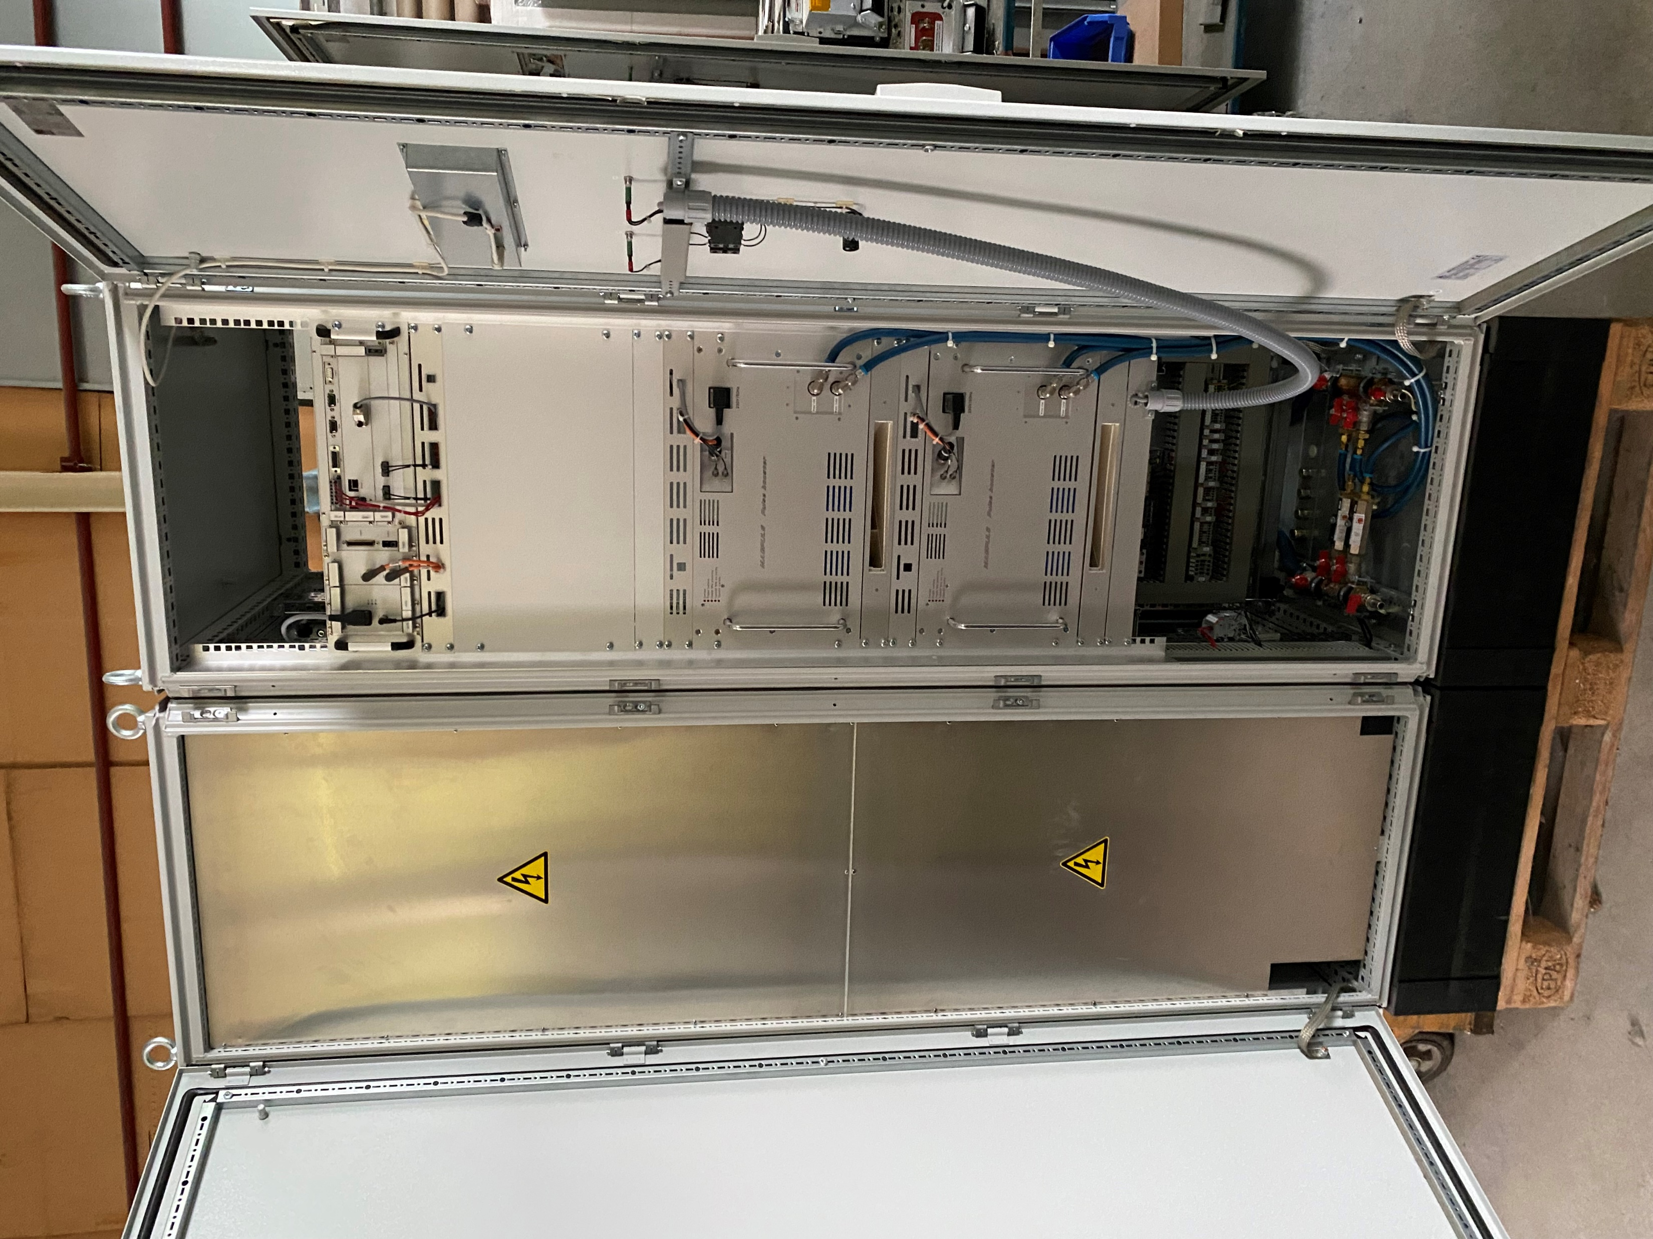
MAGPULS 800/160/1000 up QuickSwap
MAGPULS GmbH
Technical data:
DC Power : up to 160kW DC
Pulse current: up to 1000A peak
Pulse Voltage: 50 -800V
Puse On time: 5µs – 100sec.
Pulse Pause time: 5µs - 100 sec.
Pulse frequency: DC/ 0.5 Hz – 16 kHz
Duty Cycle: 0,01 % up to 99,9 %
Cooling: Water cooling
Ambient Temp.: 10°C up to 40° C
Mechanical data:
Cabinet HxBxT : 2200x1200x800mm
Construction:
Pulse unit is built up in 19“ rack mount units mounted in a cabinet with copper rail systems at the rear side for easy service and inspection.
Inclusive switch over device for oparating with 2 vacuum oven at the same time while one oven is cooling down.

Slide 6
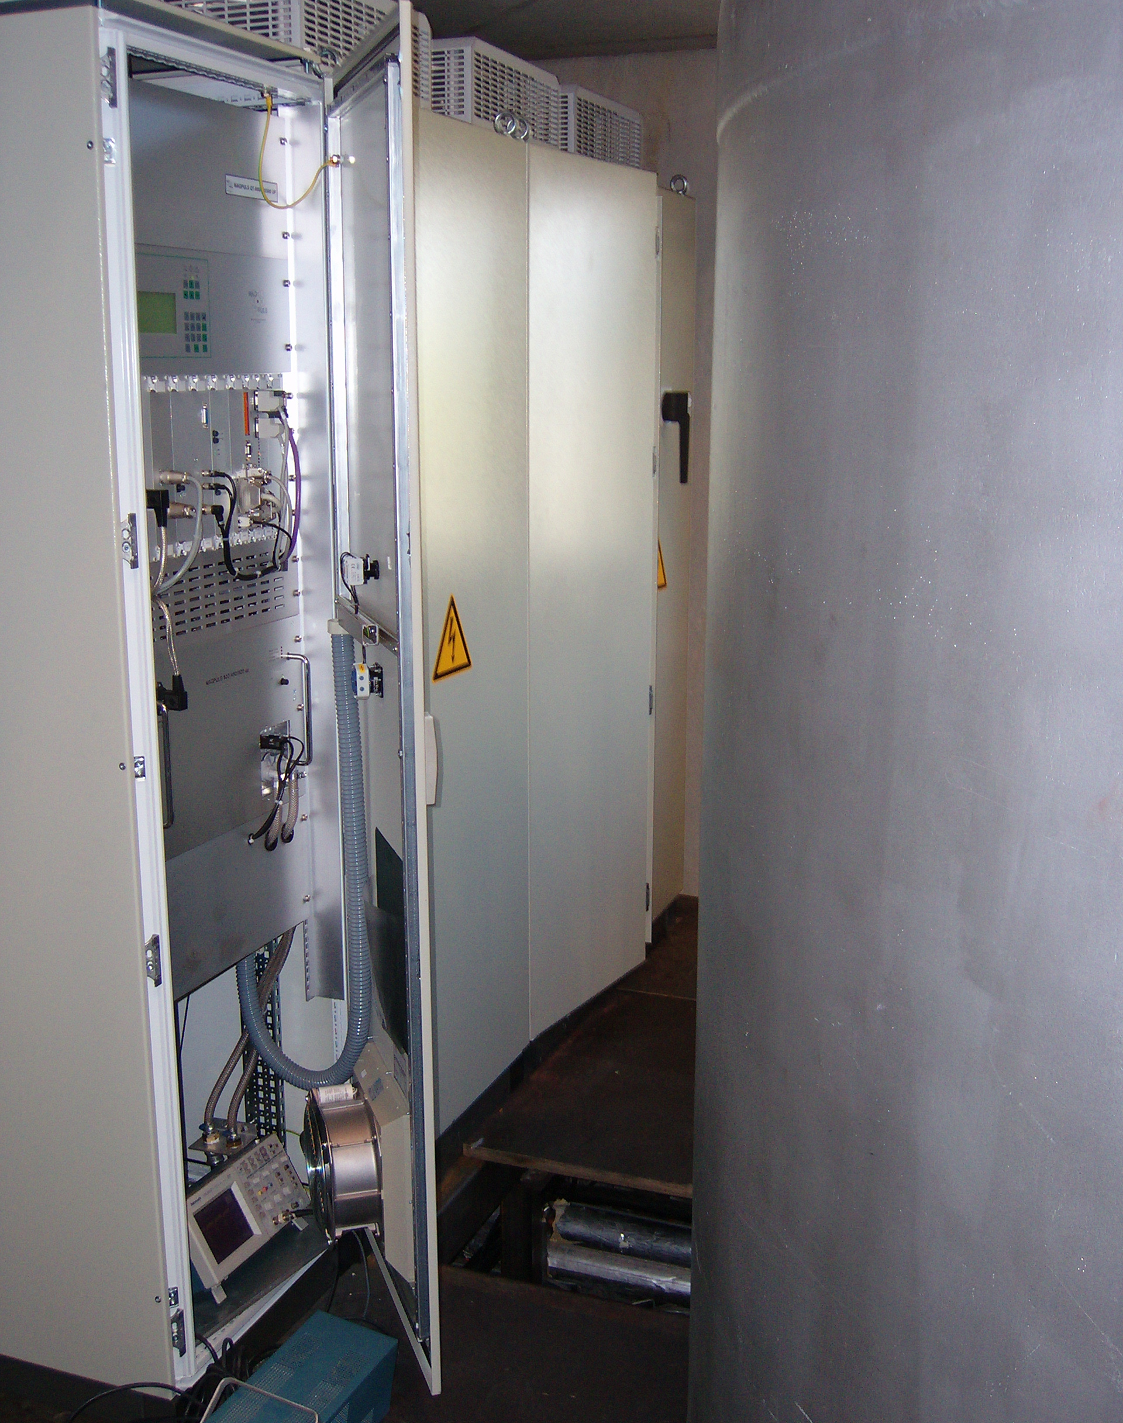
MAGPULS QT-800/450/500 up
MAGPULS GmbH
Technical data:
DC Power : 0 – 360kW DC
Pulse current: up to 500A peak
DC current: 0 – 450A DC
Pulse Voltage: 50 -800V
Puse On time: 5µs – 1000 µs
Pulse Pause time: 5µs - 1000 µs
Pulse frequency: DC/ 500 Hz – 16 kHz
Duty Cycle: 0,1 % up to 99,5 %
Cooling: Water and air cooling
Ambient Temp.: 10°C up to 40° C
Mechanical data:
Pulse unit: Cabinet HxBxT = 2200x600x800mm
DC power sypply: Cabinet HxBxT = 2200x1200x800mm
Construction:
Pulse unit is built up in 19“ rack mount units mounted in a cabinet with copper rail systems at the rear side for easy service and inspection.
Commissioning at the customer‘s site

Slide 7
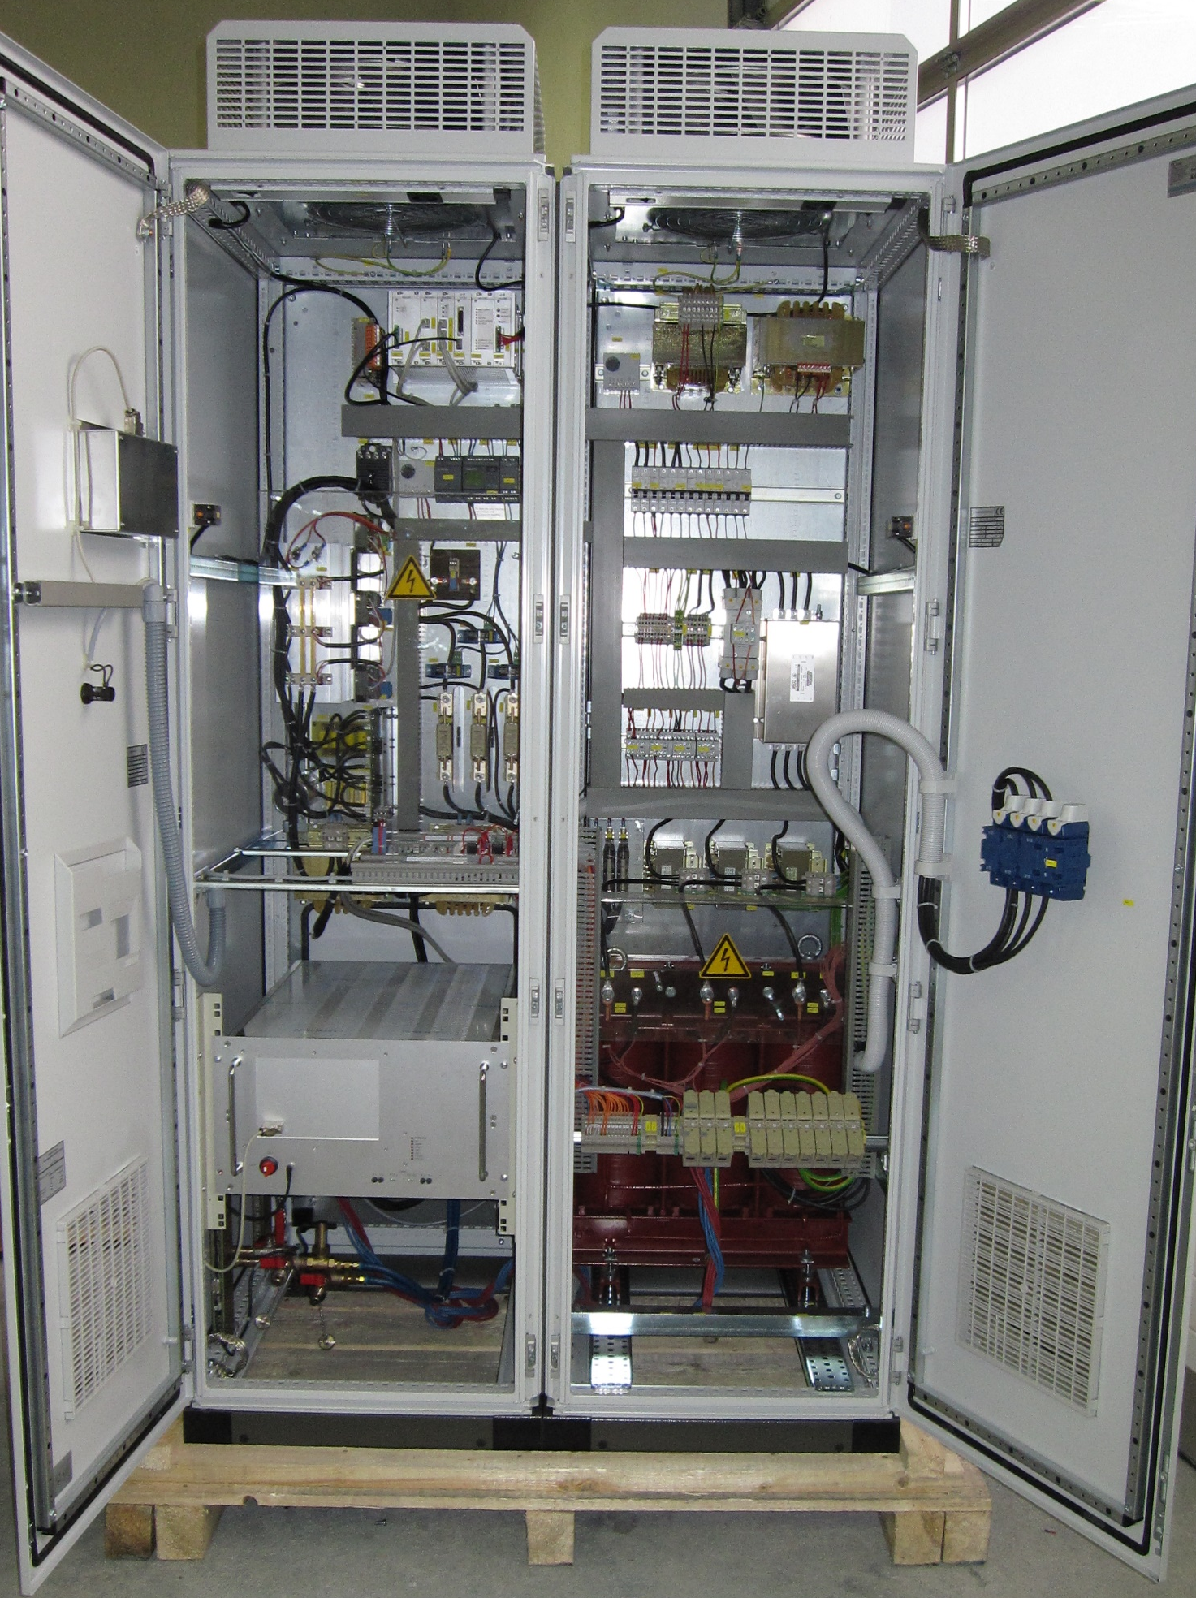
MAGPULS QT-800/50/200 up
MAGPULS GmbH
Technical data:
DC Power : 0 – 40kW DC
Pulse current: up to 200A peak
DC current: 0 – 50A DC
Pulse Voltage: 50 -800V
Puse On time: 5µs – 1000 µs
Pulse Pause time: 5µs - 1000 µs
Pulse frequency: DC/ 500 Hz – 16 kHz
Duty Cycle: 0,1 % up to 99,5 %
Cooling: Water and air cooling
Ambient Temp.: 10°C up to 40° C
Mechanical data:
Cabinet HxBxT: 2100x1200x800mm
Construction:
Pulse unit is built up in 19“ rack mount units mounted in a cabinet.
DC power supply in thyristor controlled technology

Slide 8
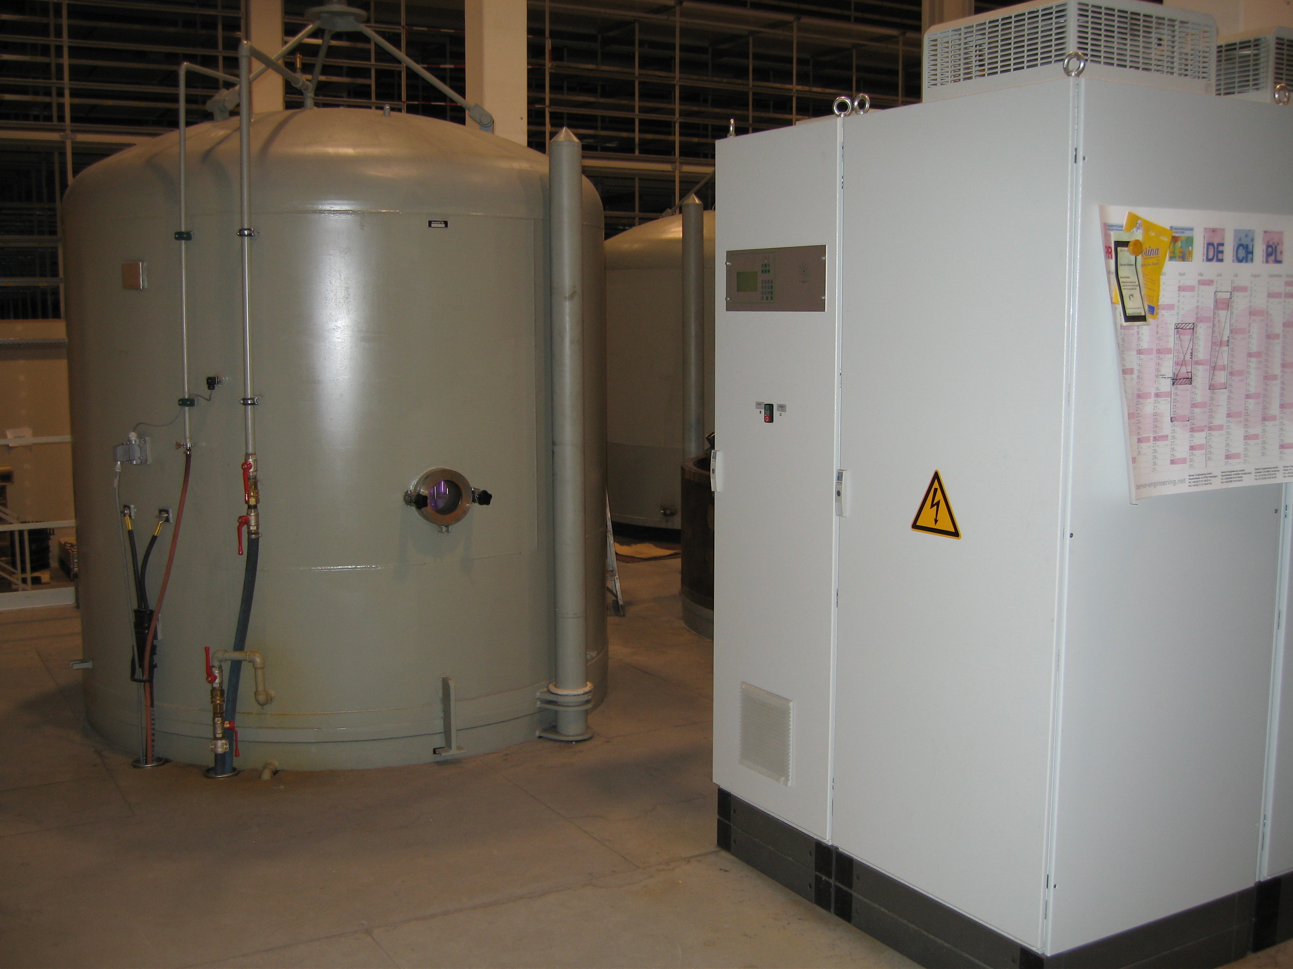
MAGPULS 800/420/1000 up
MAGPULS GmbH
Technical data:
DC Power : 0 – 340kW DC
Pulse current: up to 1000A peak
DC current: 0 – 420A DC
Pulse Voltage: 50 -800V
Puse On time: 5µs – 1000 µs
Pulse Pause time: 5µs - 1000 µs
Pulse frequency: DC/ 500 Hz – 16 kHz
Duty Cycle: 0,1 % up to 99,5 %
Cooling: Water and air cooling
Ambient Temp.: 10°C up to 40° C
Mechanical data:
Pulse unit: Cabinet HxBxT = 2200x600x800mm
DC power sypply: Cabinet HxBxT = 2200x1200x800mm
Construction:
Pulse unit is built up in 19“ rack mount units mounted in a cabinet with copper rail systems at the rear side for easy service and inspection.
DC power supply in thyristor controlled technology
System in operation at customer‘s site

Slide 9
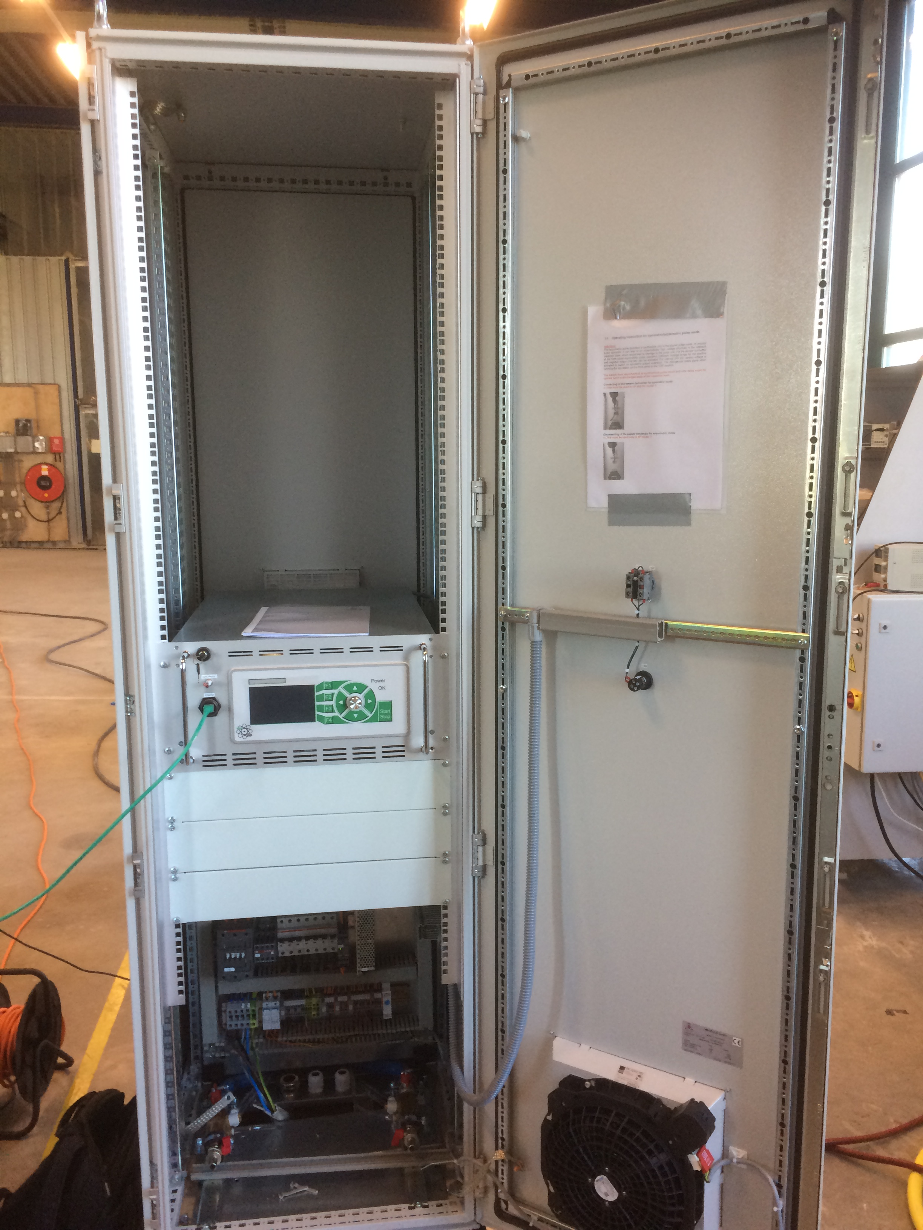
MAGPULS QP-800/400 up
MAGPULS GmbH
Technical data:
DC Power : 0 – 40kW DC
Pulse current: up to 400A peak
DC current: 0 – 80A DC
Pulse Voltage: 50 -800V
Puse On time: 2µs – 100 sec
Pulse Pause time: 2µs - 100 sec.
Pulse frequency: DC/ 500 Hz – 20 kHz
Duty Cycle: 0,01 % up to 99,9 %
Cooling: Water and air cooling
Ambient Temp.: 10°C up to 40° C
Mechanical data:
Pulse unit: 19“ x 6HU x 650mm
DC power supply: 2 x ( ½ 19“ x 4HU x 600mm)
Pulse unit and DC power supplies mounted in a cabinet

Slide 10

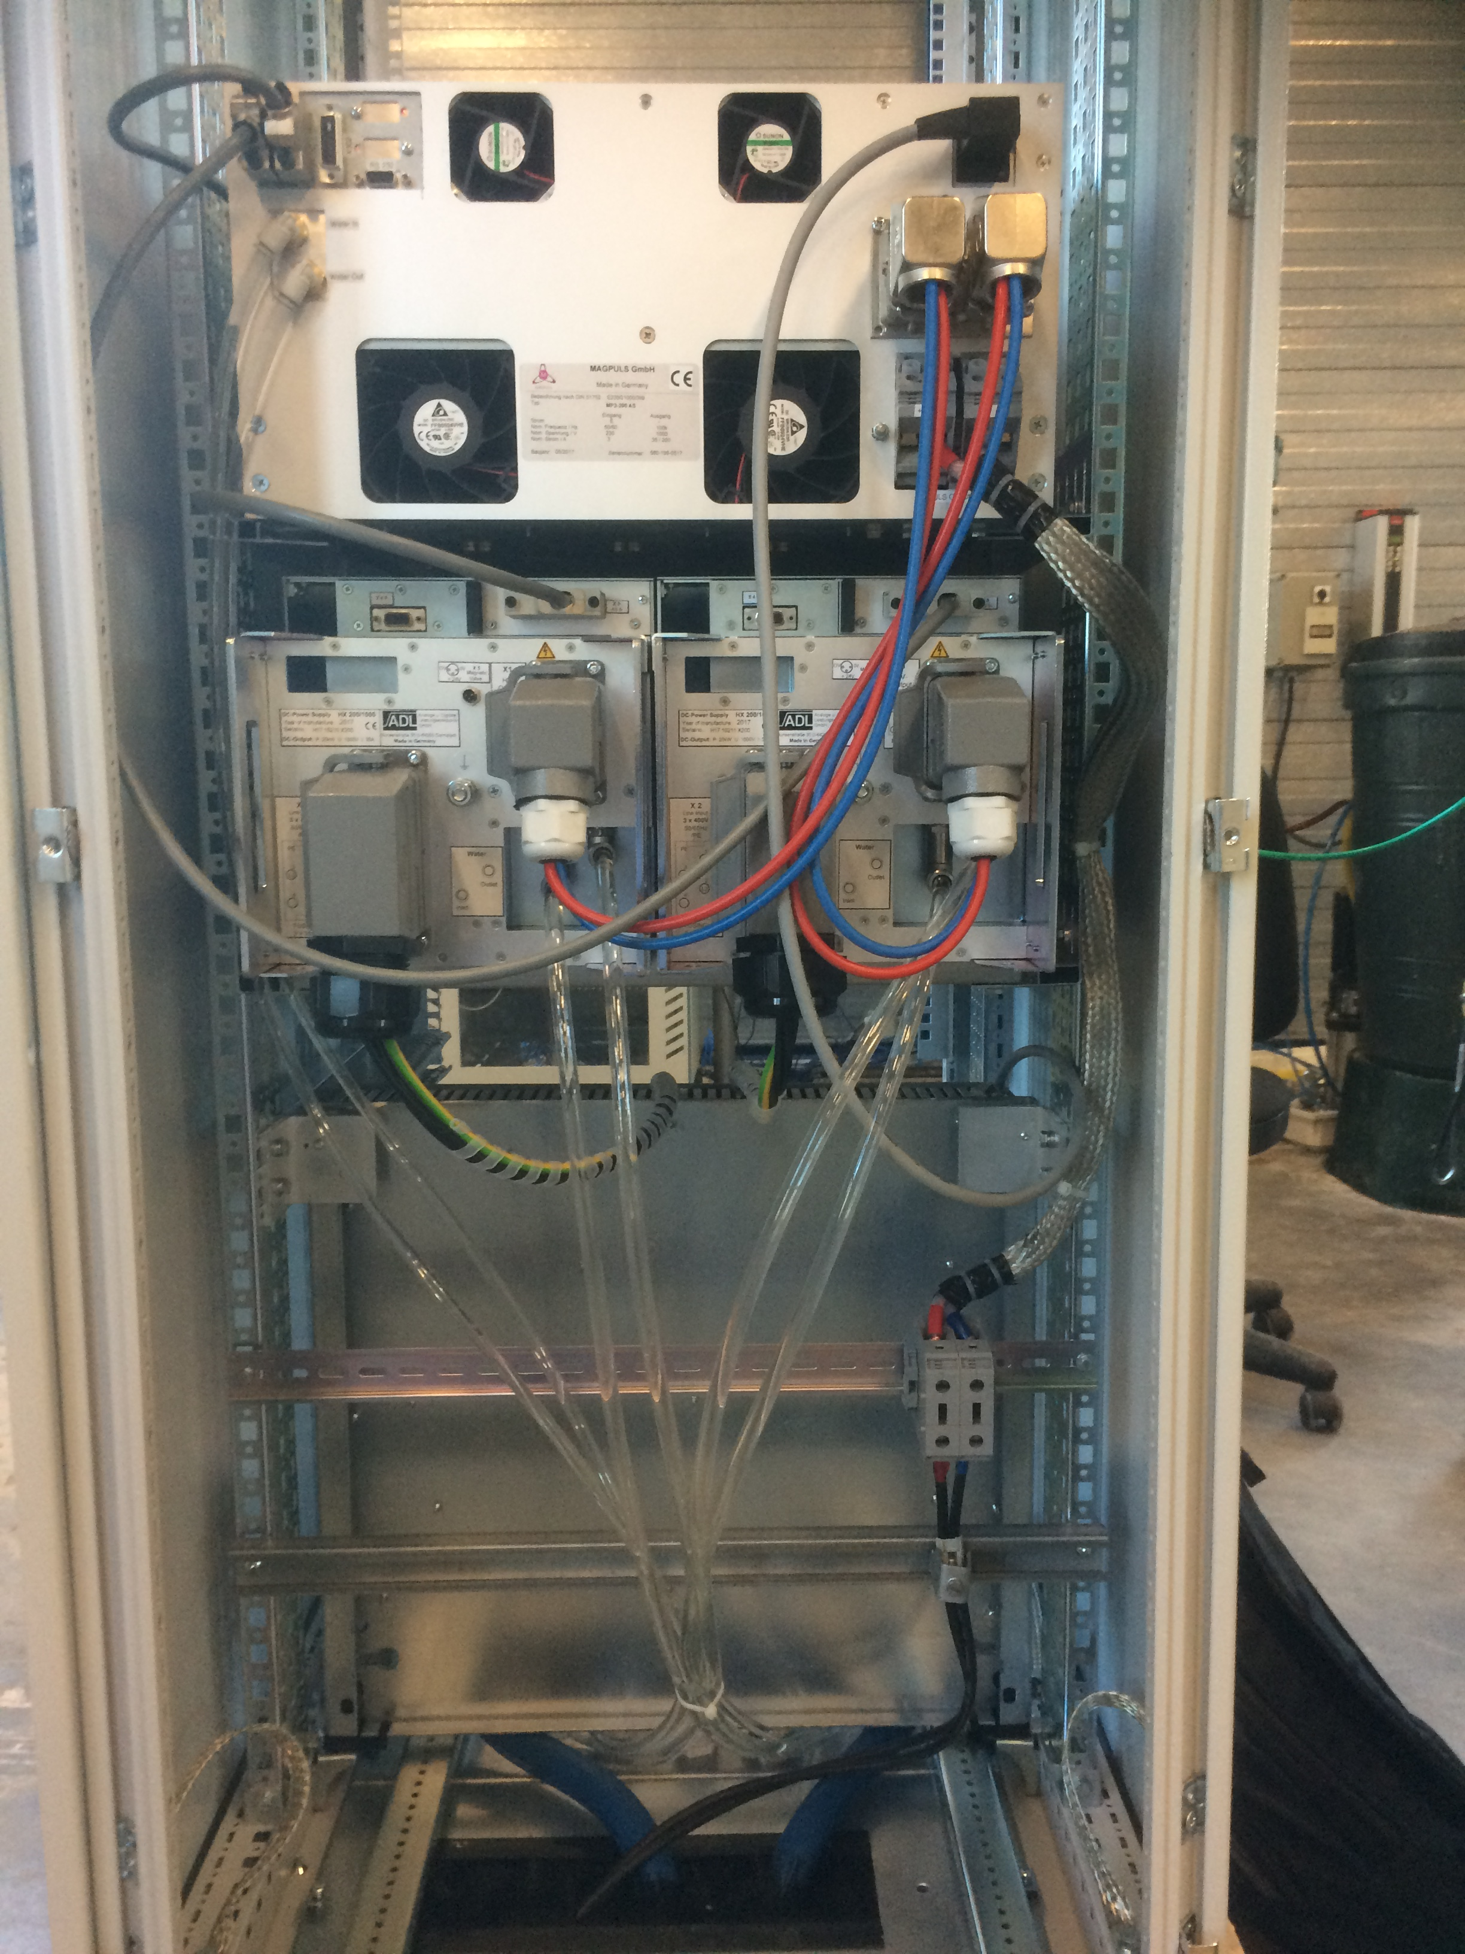
Connecting at the rear side
MAGPULS GmbH

